Slide 1
Criminal Minds Memory Game
Leader: Fahim Ahmed
Developers: Fahim ahmed & Zaheer Tajani
Description: Just a simple matching game with Current and recurring actors of criminal minds

Slide 2
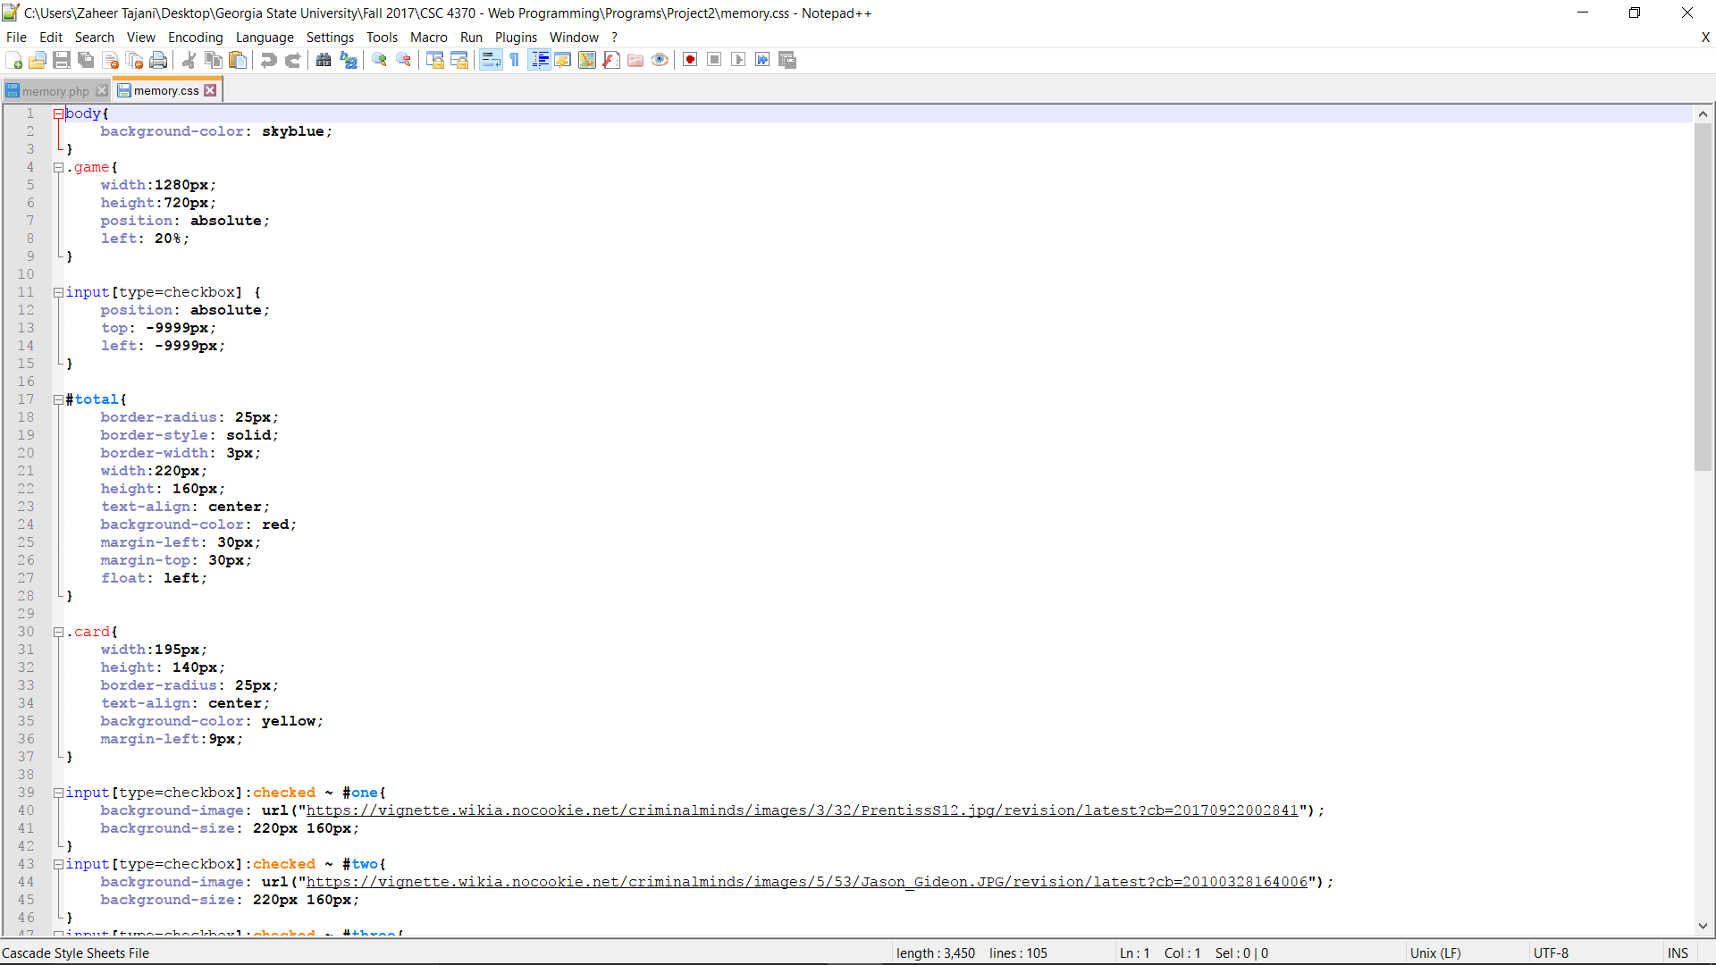
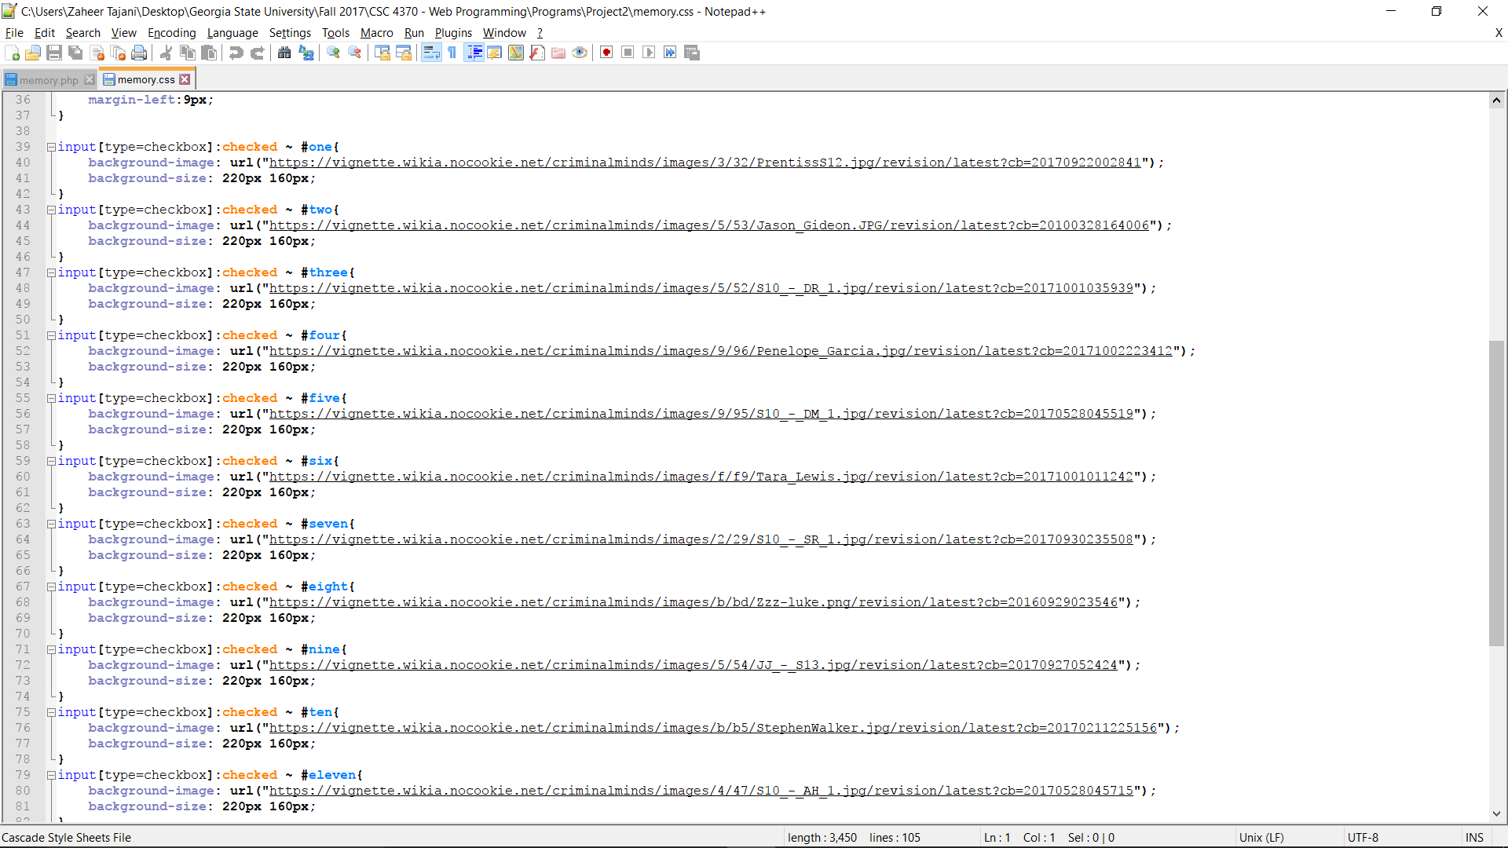
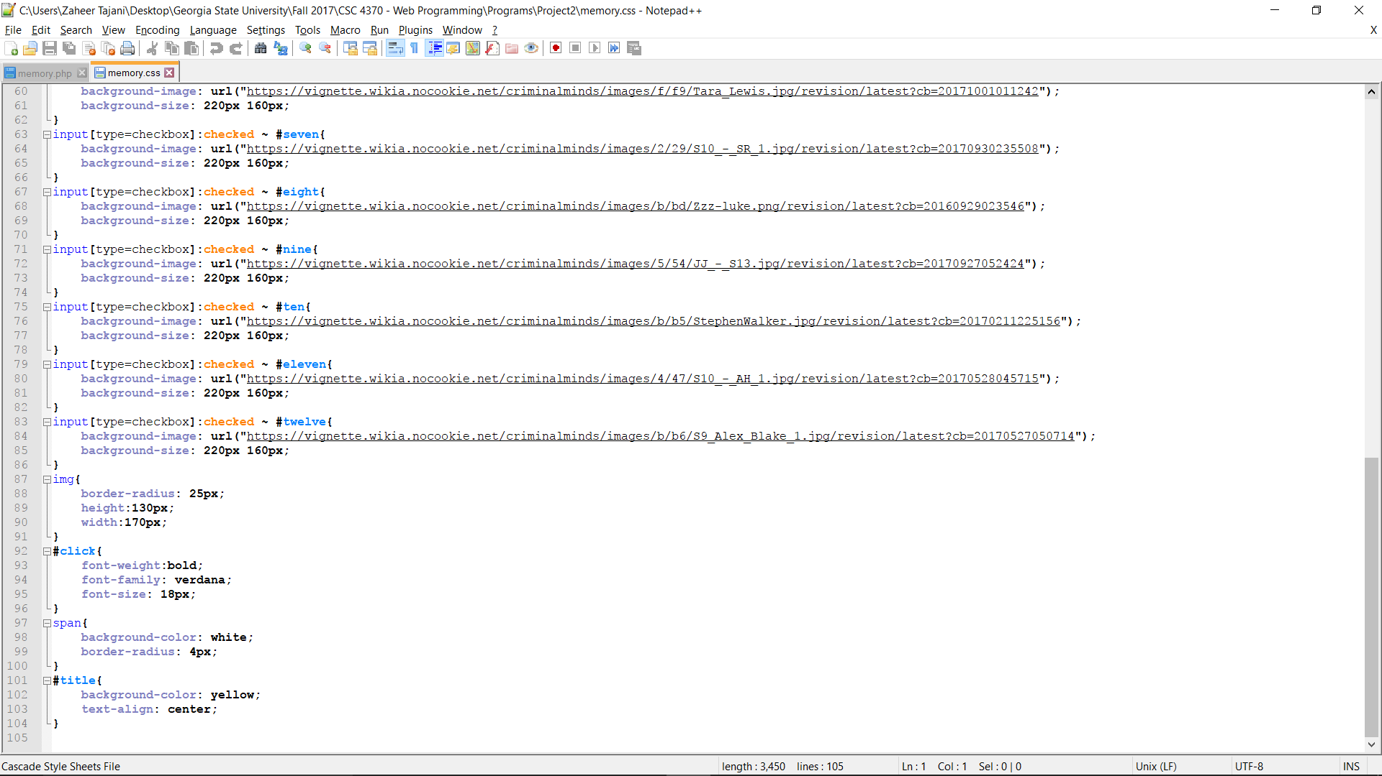
Code snippets

Slide 3
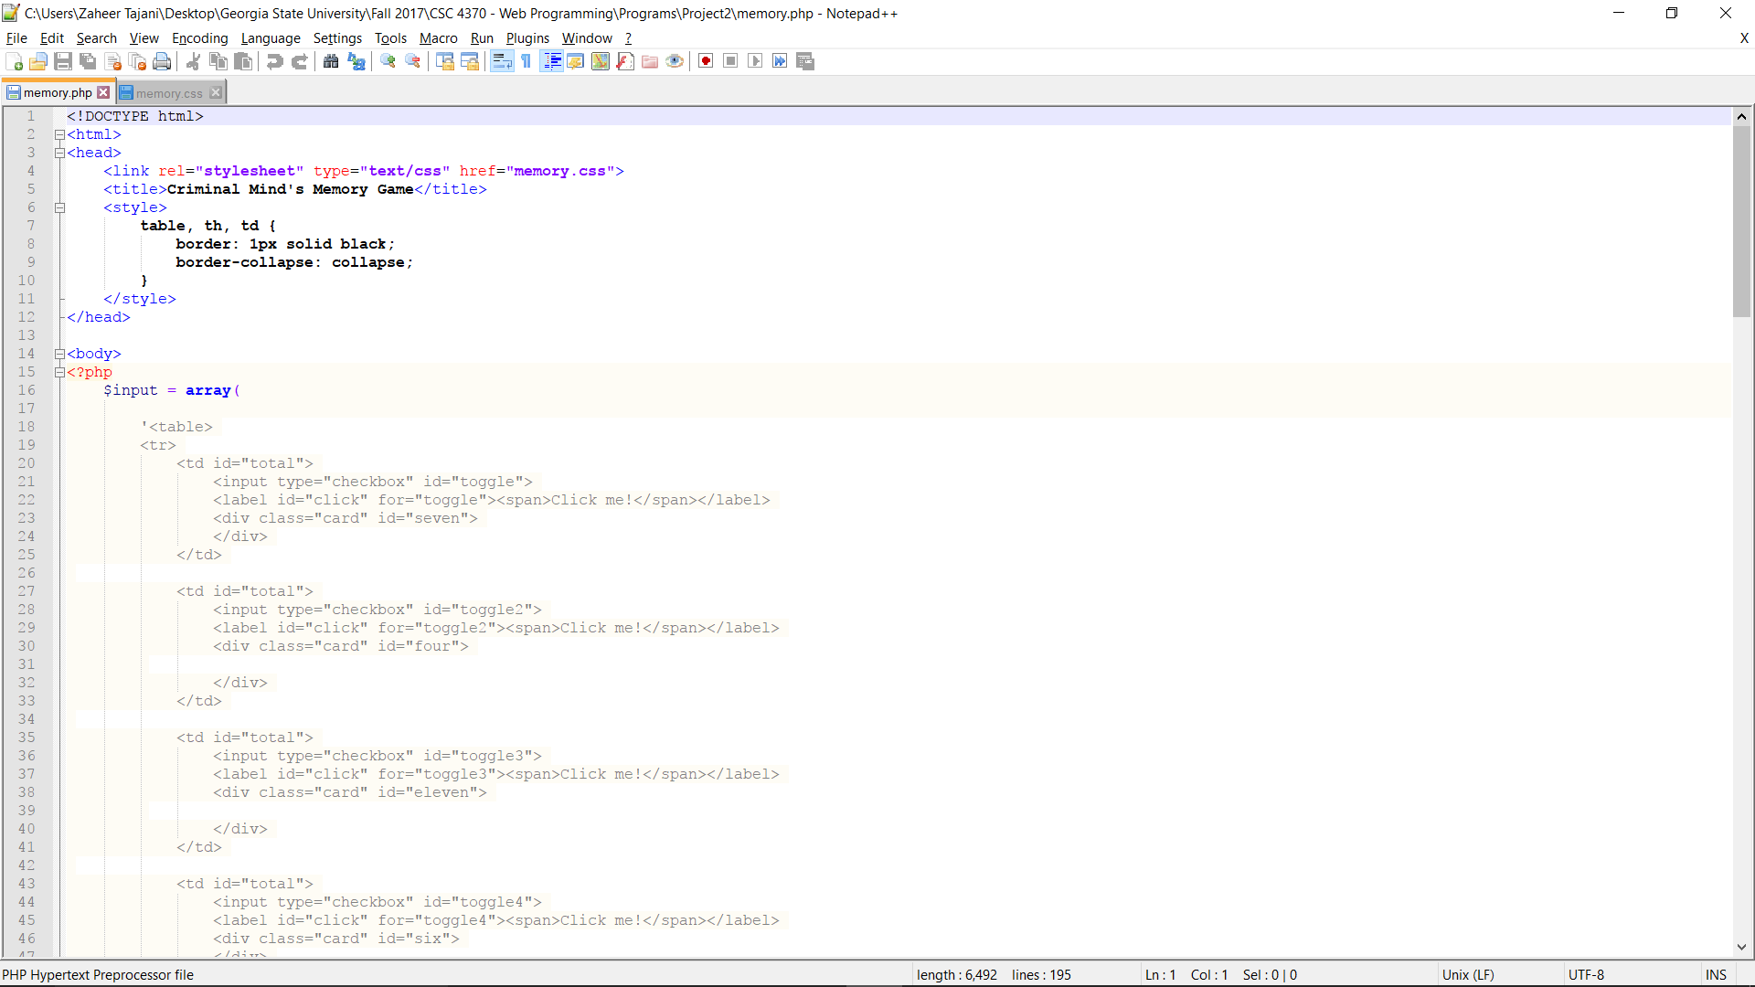
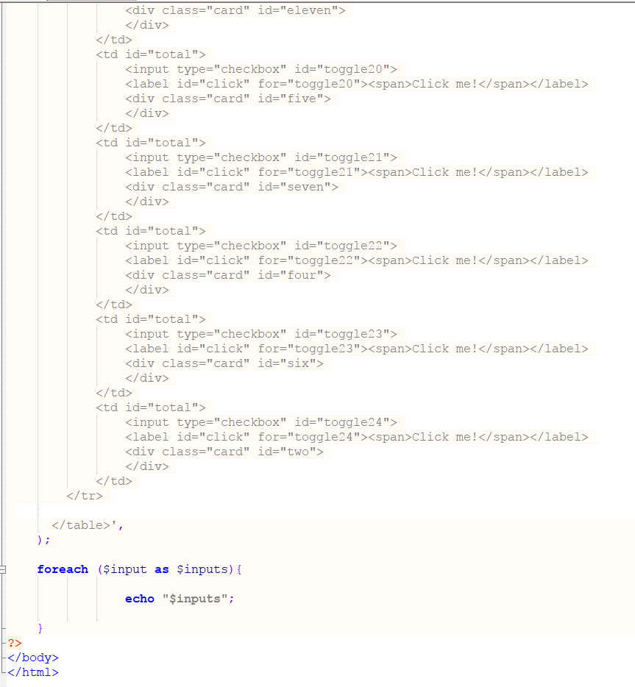
Code snippets cont.

Slide 4
Memory game Rules and Description
To play the game, click where it says “Click Me” and match the character pictures.
Total of 12 characters and 24 cards.
If you do not match the correct cards, click “Refresh” on the webpage to start over or just click the picture to flip it back over.
Once you successfully match the cards, you have completed the game.

Slide 5
Demo Time

